Slide 1
Arduino Workshop #10
Hardware and Timer Interrupts

Slide 2
PowerPoint and Code
Github.com/EELabMan
Go To Repositories and find Arduino 10 Hardware and timer interrupts

Slide 3
Interrupts
An Interrupt's job is to make sure that the processor responds quickly to important events. When a certain signal is detected, an Interrupt (as the name suggests) interrupts whatever the processor is doing, and executes some code designed to react to whatever external stimulus is being fed to the Arduino.

Slide 4
Hardware Interrupts

Slide 5
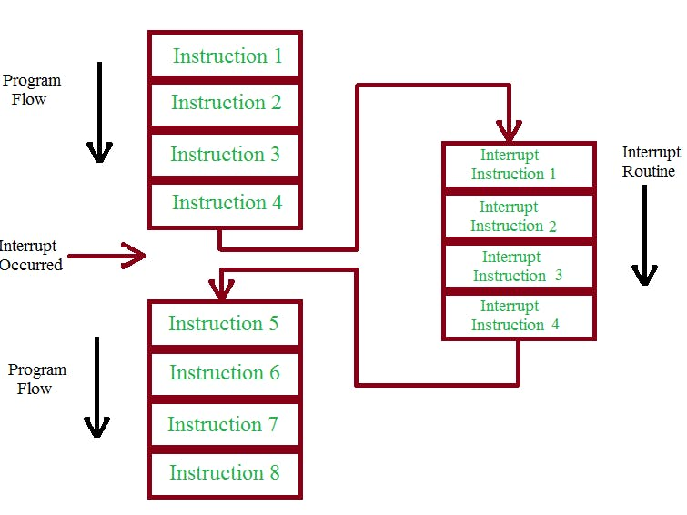
Hardware

Slide 6
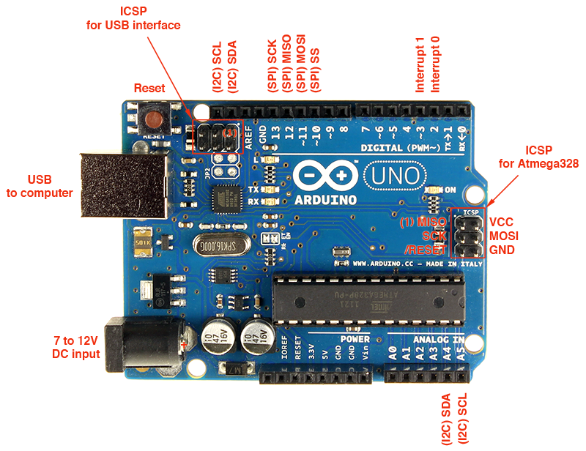
Interrupt Pins on Arduino UNO
The Uno only has two pins that can act as interrupts.
Pin2 = Interrupt 0
Pin3 = Interrupt 1
The Arduino MEGA has 6 interrupts

Slide 7
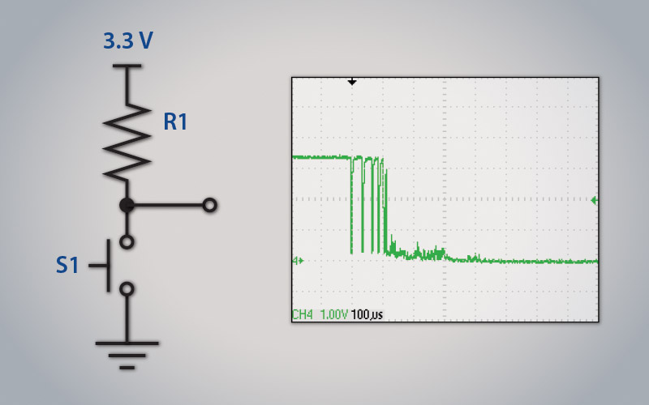
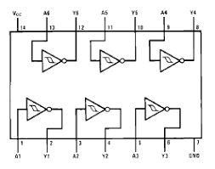
Debounce
Buttons and switches are not perfect.
When Pressed, they “Bounce” the voltage before setting on their pressed voltage.
We will use the 74HC14 Hex Inverting Schmitt trigger IC to ensure the button works correctly.
This is the hardware version of a debounced button.

Slide 8
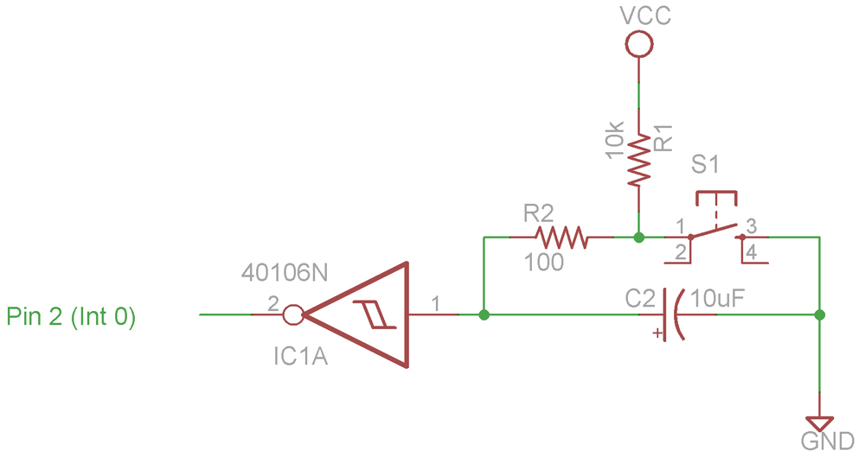
Button Debounce with
Input of inverter is tied to VCC. When button is pressed, the capacitor discharges slowly through resistor.
When pin 1 is at a critical voltage the inverter output will go high.
Button release is opposite.

Slide 9
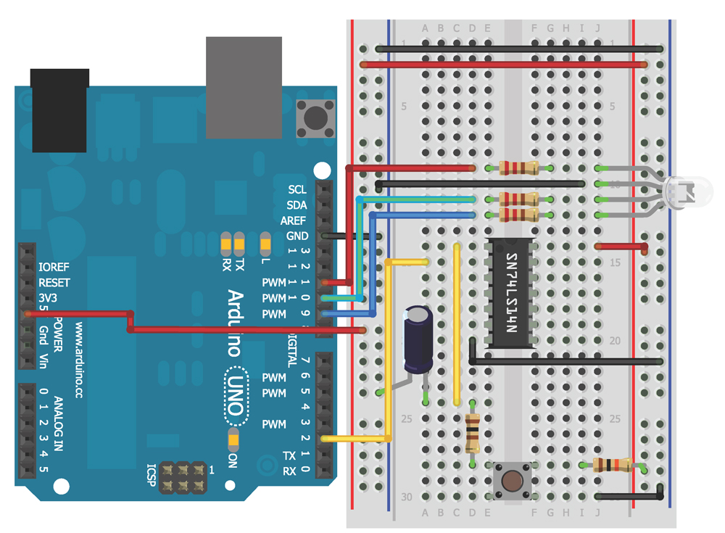
The Circuit

Slide 10
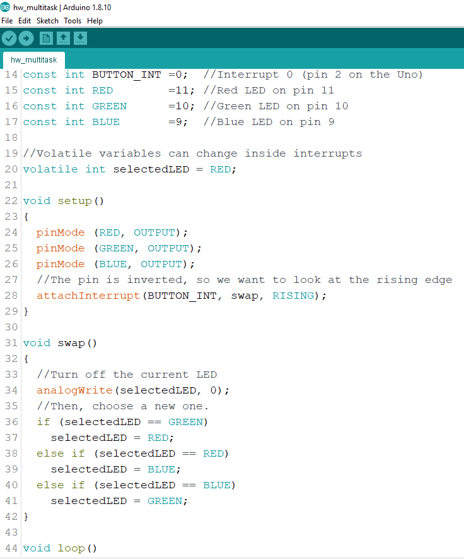
The Code
Download from UTA EE GitHub hw_multitask.ino
We will need to install a library file for this sketch.
Let’s look at the code.

Slide 11
Timer Interrupts
The Crystal Oscillator (XOSC) on the Arduino runs at 16MHz.
Timer1 is a 16 bit timer, meaning that it can count up to 2¹⁶-1, or 65,535.
Once Timer1 reaches 65,535 it resets to 0 and starts all over again.

Slide 12
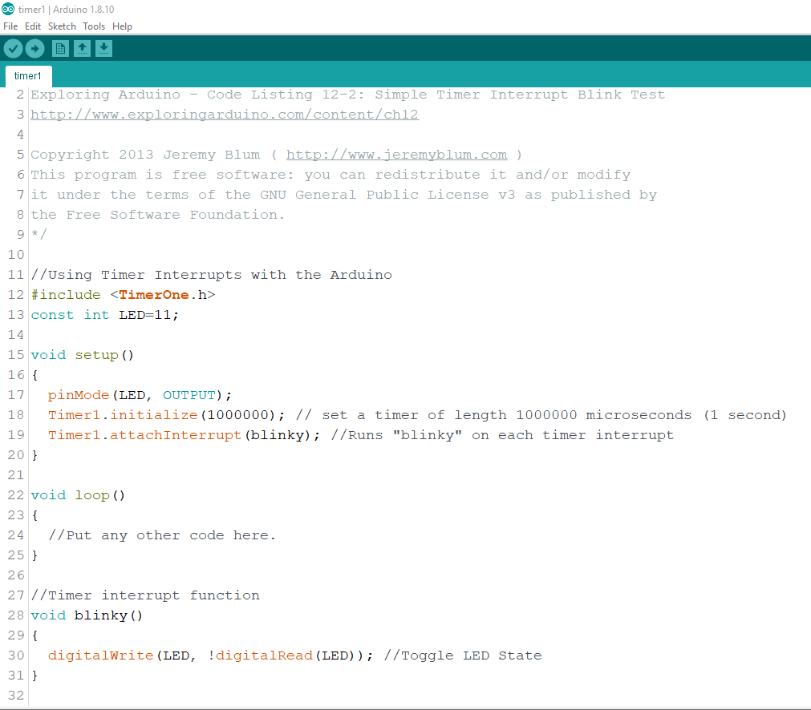
The Code
Download the TimerOne-master.zip file and put it in the Arduino libraries folder.
Sketch-> Include Library -> Add ZIP Library. Then select the TimerOne-master.zip file.
Download the Timer1.ino file and upload it.
Let’s look at the code

Slide 13
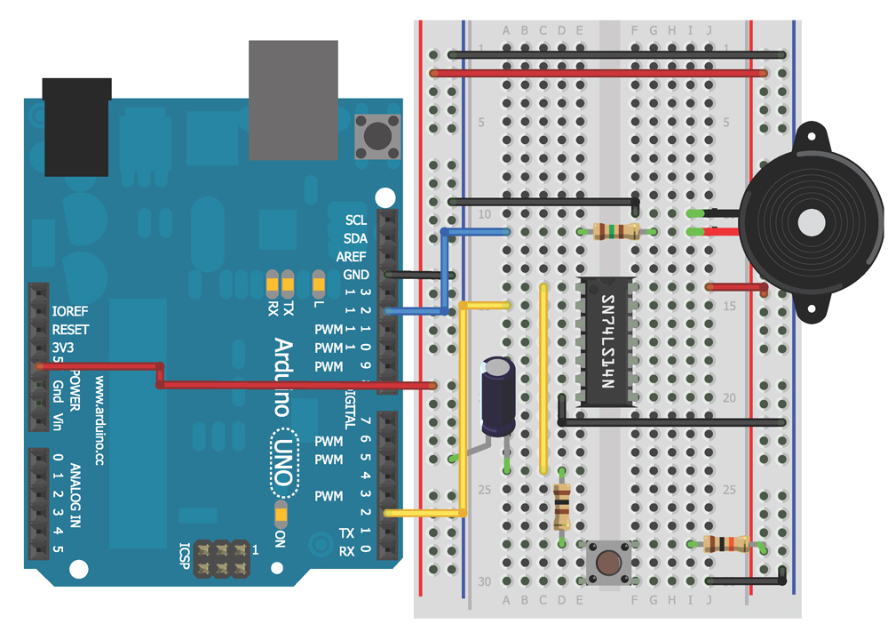
Sound Machine

Slide 14
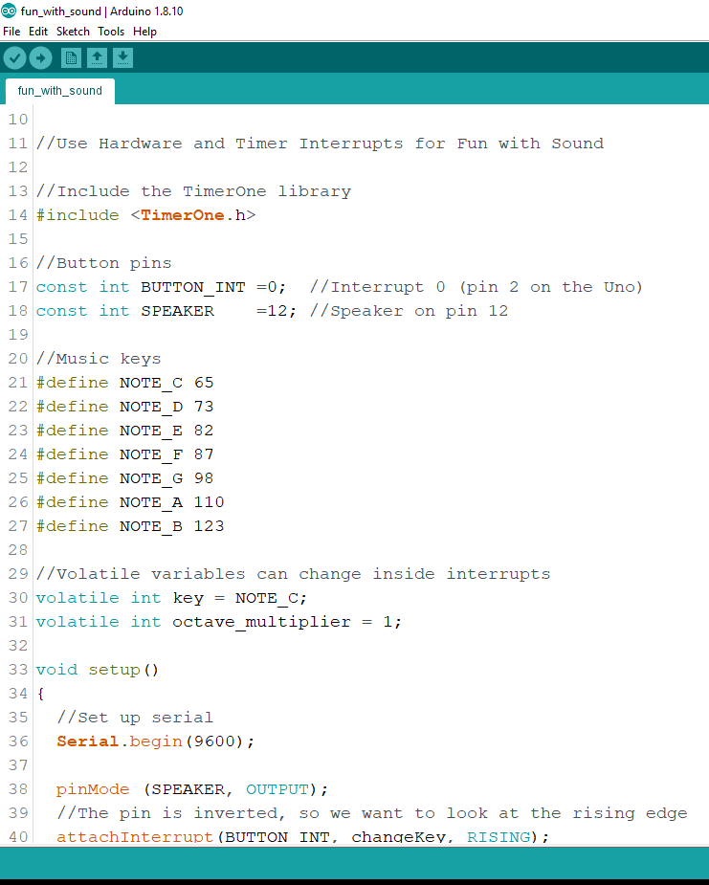
The Code
Download the fun_with_sound.ino file and upload it.
Let’s look at the code

Slide 15
Visual Proof
Measure the input ( Pin1 of the 74HC14) on Channel 1 of the oscilloscope
Measure the output (Pin 2 of the 74HC14) on Channel 2 of the oscilloscope.
Adjust the oscilloscope until you see your button presses on both channels.
Save the picture and/or data to your USB drive if you would like.

Slide 16
Stay tuned
Arduino 11 we will build a Room Entry Logger and read and write to SD cards!

